Slide 1


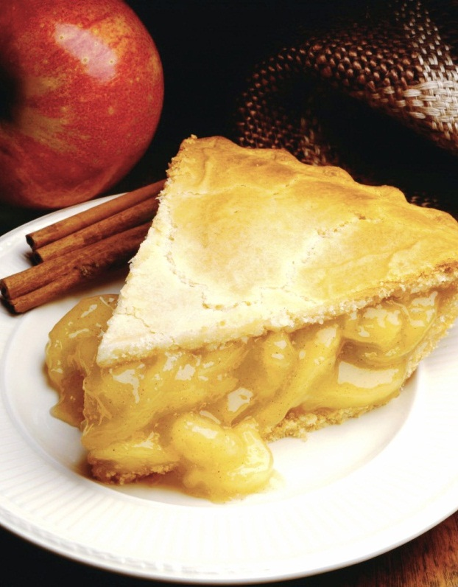
BUSINESS CASE (Online Food Ordering System)
Group G : Techno Geeks
NG ZHENG YI 245278
MAT KHAIRUL HANIF BIN ABU SEMAN 245637
SAIFARAHANA BINTI A.JALIL 245313
NURUL FATIN SHAZZWANIE BINTI SHAMSUDIN 245465
Notes:
NOTE: To replace a picture, just select and delete it. Then use the Insert Picture icon to replace it with one of your own!

Slide 2

FoodHub is an online food delivery system which provides food delivery services to public
FoodHub is a convenience online food delivery site connects people with the best restaurants around them
FoodHub is also a platform for food business’s owner to improve and upgrade their business in new level by promoting it online

Slide 3
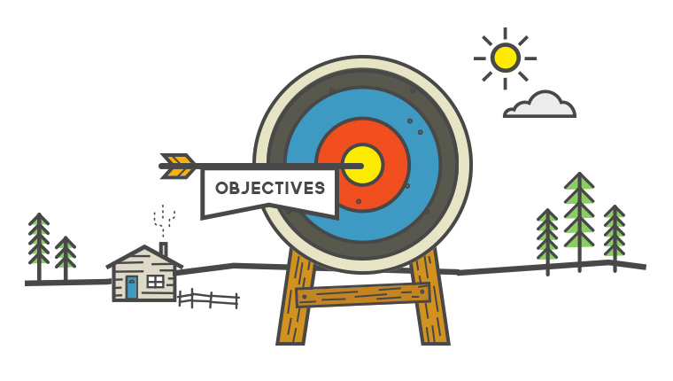
To create a new channel for users to order foods
To make a profit or surplus for the company
To provide all food sellers to have delivery service platform
To offering wholesome, fairly priced, ethnically diverse food options
To design a system able to accommodate huge amount of orders at a time
To evaluate its performance and acceptability in terms of security, user-friendliness, accuracy and reliability.

Slide 4


Current Situation and Problem / Opportunity Statement
i. Did not have delivery platform
ii. Difficult to buy food
iii. Time constraints to getting out

Slide 5


Critical Assumptions and Constraints
Assumptions
Constraints
Food delivery takes a long time
Company suffered losses
The application is difficult to used
The food can be delivered within the estimated time
The sellers will become business partner to the company
Customer can easily access the application

Slide 6

Analysis of Option and Recommendation
Idle. Since the system is in satisfactory condition, so we can continue operate without making any changes to system.
Promoting within social media to grab users’ attention
Make profit from advertisement placements inside applications
Enhancing the GUI to make it looks fascinating and eliminate any potential flaws
Expand our service for abroad with supporting multiple language

Slide 7

The project team needed to have 10 high performance computers and some other supporting equipment include network for develop and maintaining the application
The project team must at least 2 programmers, 1 IT technician and the project manager
The project team is required to setup an approach as the development guidelines
The application require to access on internet and GPS of user device
The application should be able to cover whole nation area
The application must have good confidentiality to safeguard the transaction of the users, so we need to seek for bank collaboration

Slide 8
Budget Estimate and Financial Analysis
 | Cost per Unit/Day | Amount | Duration | Total
 | RM |  | Days | RM
Project Management
Project Manager Salary | 480 | 1 | 90 | 43 200
Programmer Salary | 400 | 2 | 90 | 72 000
IT Technician Salary | 360 | 1 | 90 | 32 400
Team Member Salary | 320 | 6 | 90 | 172 800
Subtotal |  |  |  | 320 400

Slide 9
 | Cost per Unit/Day | Amount | Duration | Total
 | RM |  | Days | RM
Development Platform
Computer Device | 5 000 | 10 |  | 50 000
Other Device |  |  |  | 30 000
Installation Fee |  |  |  | 5 000
Application License |  |  |  | 10 000
Server | 10 000 | 10 |  | 100 000
Accessories |  |  |  | 3 000
Subtotal |  |  |  | 198 000

Slide 10
 | Cost per Unit/Day | Amount | Duration | Total
 | RM |  | Days | RM
Operating Cost
Internet | 1 200/month |  | 90 | 3 600
Utilities | 10 000/month |  | 90 | 30 000
Insurance | 5 000/month |  | 90 | 15 000
Management Fee | 100 |  | 90 | 9 000
Maintenance | 2 000/month |  | 90 | 6 000
Subtotal |  |  |  | 63 600

Slide 11
 | Cost per Unit/Day | Amount | Duration | Total
 | RM |  | Days | RM
Testing
Software Testing |  |  |  | 30 000
Subtotal |  |  |  | 30 000
Reserve
Dinner Celebration |  |  |  | 2 000
Emergency Reserve |  |  |  | 20 000
Other Reserve |  |  |  | 30 000
Subtotal |  |  |  | 52 000
Total Cost Estimation |  |  |  | 664 000

Slide 12
Schedule Estimate
Online Food Delivery System | 2018
 | March |  |  |  | April |  |  |  | May
 | Week 1 | Week 2 | Week 3 | Week 4 | Week 5 | Week 6 | Week 7 | Week 8 | Week 9 | Week 10 | Week 11 | Week 12
Recruiting Team Members
Planning
Information Gathering
Objective
Proposal
Seeking Approval
Analysis Project Requirement
Design
Constructing Project
Requirement Confirmation
Application Testing
Finalize Configuration

Slide 13

Potential Risk
i. Financial Risk
ii. Competitive Risk
iii. Food Quality Risk
iv. Accident Risk
v. Food Availability Risk

Slide 14
FoodHub Sdn.Bhd

